Slide 1
London Housing Case Study
By: Melissa Barona
Springboard Data Science Bootcamp
12/23/2021

Slide 2
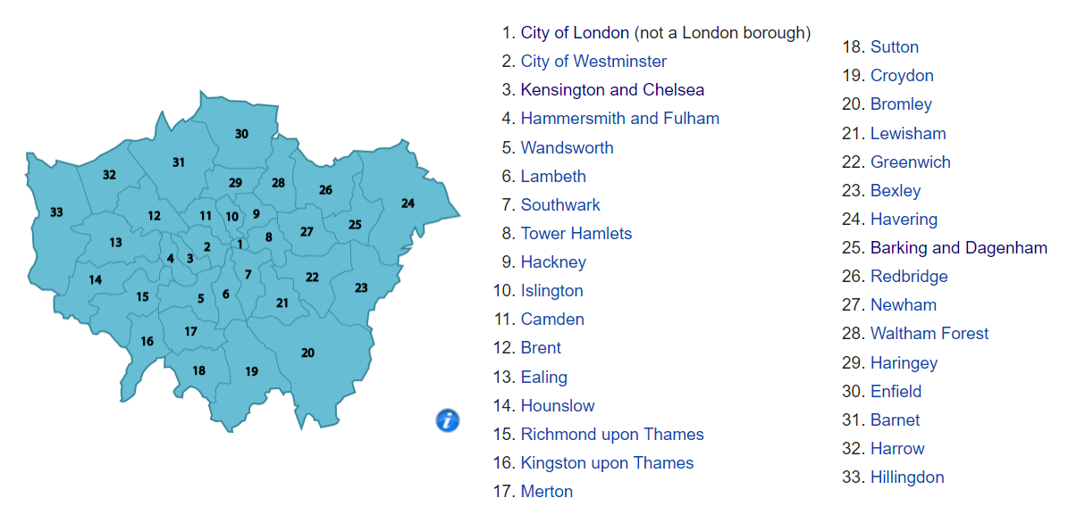
Objective
Which borough of London has seen the greatest average increase in housing prices over the past two decades?
City of London, local government
Dataset obtained from:
London Datastore
https://data.london.gov.uk/
https://en.wikipedia.org/wiki/London_boroughs

Slide 3
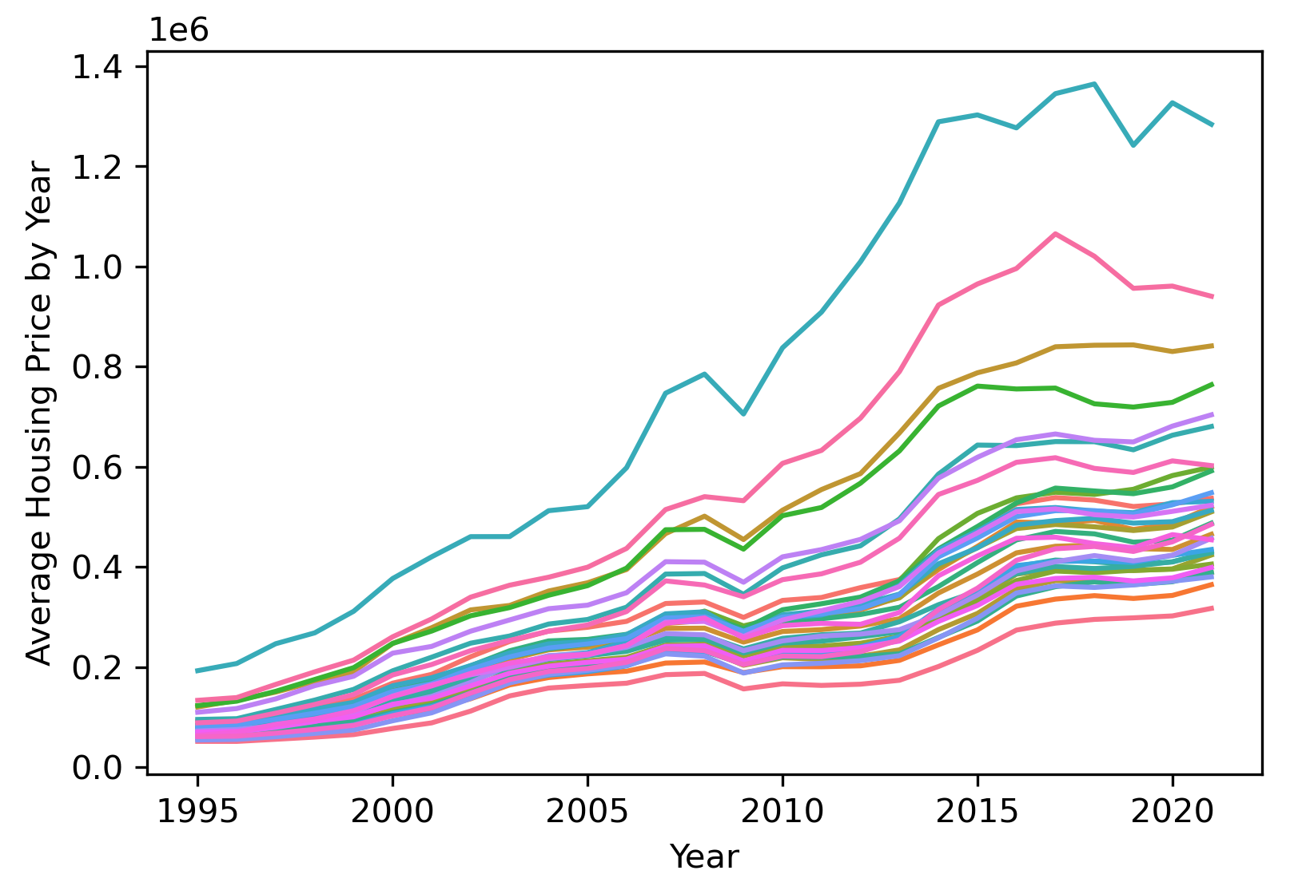
Kensington & Chelsea and Westminster have the highest housing prices
Kensington & Chelsea
Westminster

Slide 4
Housing prices decreased in 2008 and 2017

Slide 5
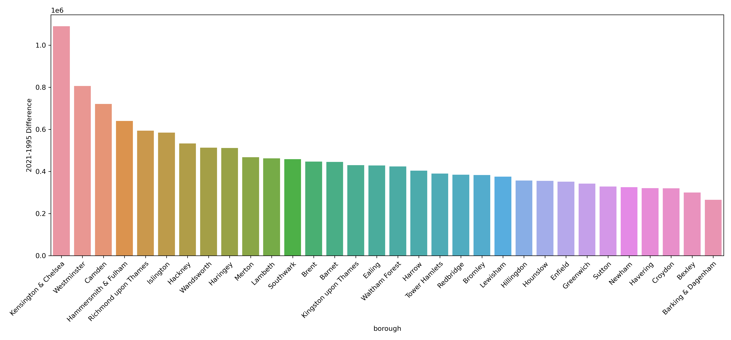
Housing prices have increased the most in Kensington & Chelsea, Westminster, and Camden
Difference in average housing prices between 1995 and 2021
~ 0.7 – 1 M Euros

Slide 6
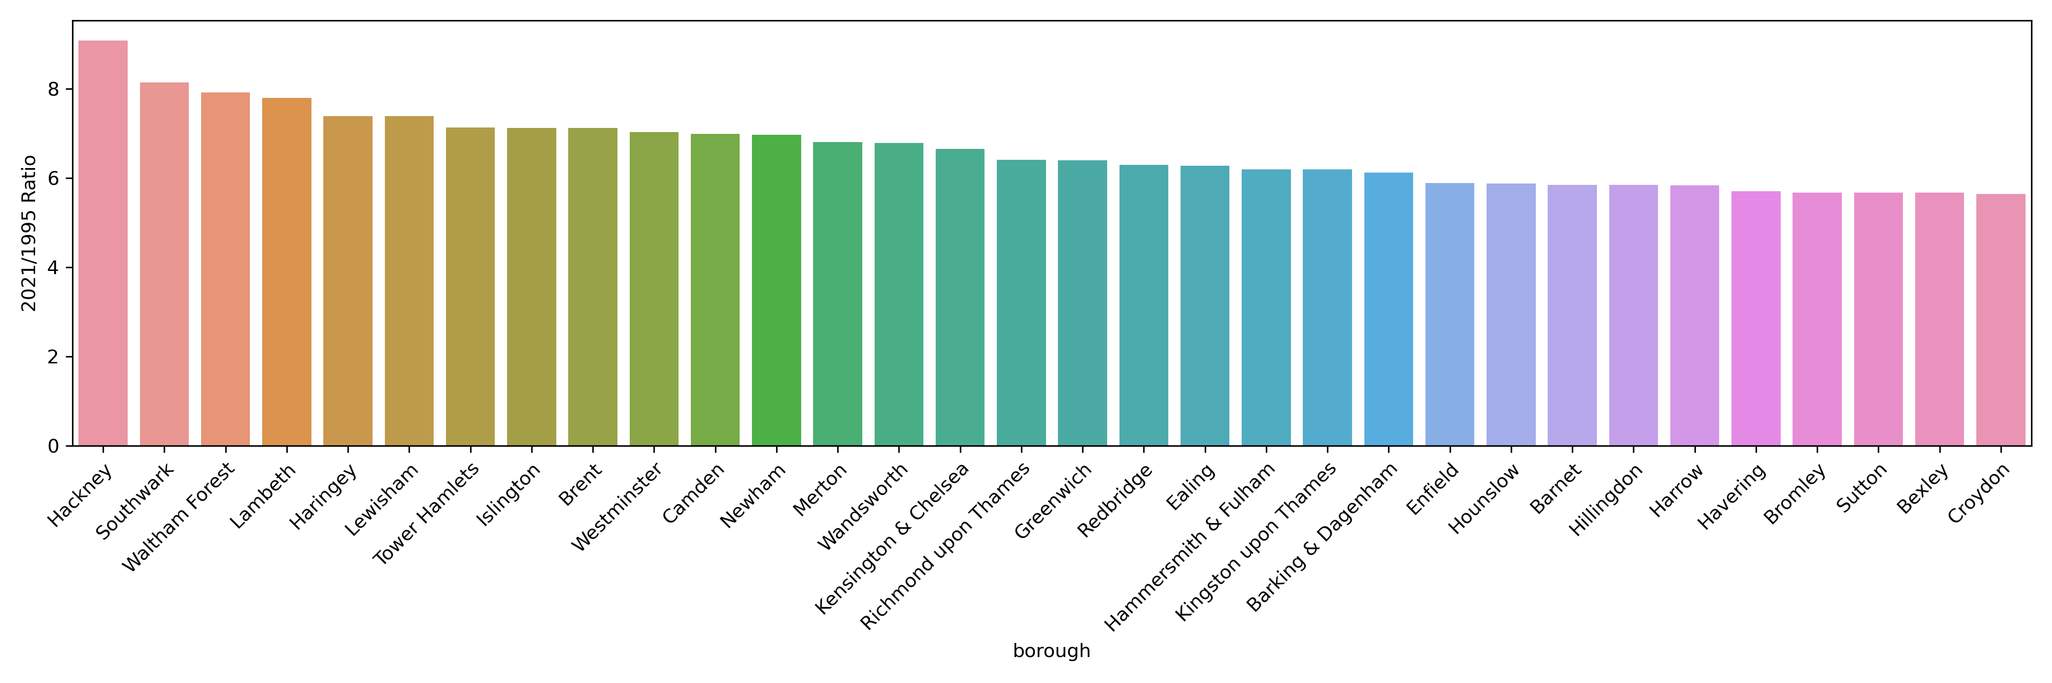
Housing prices have grown the most by a factor of 8-9 in Hackney, Southwark, and Waltham Forest
Ratio between average housing prices in 2021 vs. 1995
8-9 times higher

Slide 7
London boroughs to the east of the City of London are promising housing markets
Most expensive markets are to the west of the City of London:
Kensington & Chelsea
Westminster
Camden
Less expensive but fastest growing markets are to the east of the City of London:
Hackney
Southwark
Waltham Forest

Slide 8
Further things to investigate
Can we predict how much the market may continue to grow in Hackney, Southwark and Waltham Forest boroughs?
What opportunities are there in the least expensive boroughs to make them promising markets in the future?

